Slide 1
A short heliospheric demo
Vincent Génot and the CDPP/3DView team
Ecole des Houches / Solar Orbiter
April 2021

Slide 2
Objectives
Display Solar Orbiter, Parker Solar Probe and BepiColombo trajectories together with Earth, Venus, Mercury and Mars
3D view + lon/lat display
Parker field line tracing
Connect-tool maps for better connectivity
Instrument FOV
http://3dview.cdpp.eu/

Slide 3
Setting the scene
In desktop bar: File/New scene
In « scene 1 » window: Manage scene
In Manage scene:
leave the dates as they are
Add SO, PSP, Bepi
Change the coordinate system to HEE
In « Natural bodies »: add planets
Click ok
In Camera: click 2DView
In the 2D View window: click Camera and choose Projection>cylindrical

Slide 4
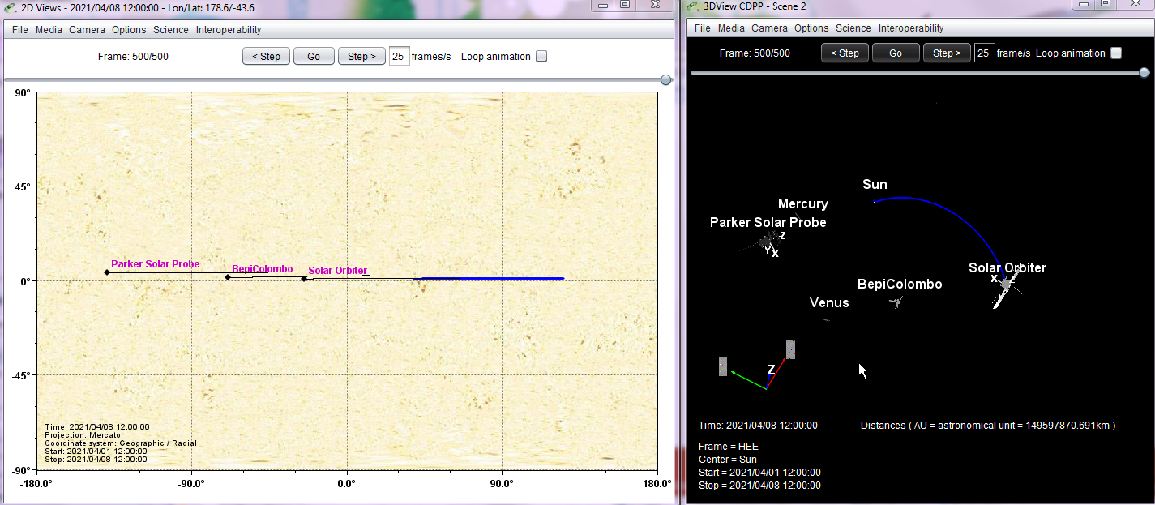
Add more information
In the « scene 1 » window: click Science/Models
In the « models » window: Sun/Specific/Parker spiral
Click « follow scene object / choose your spacecraft »
Adjust the solar wind velocity: see how the line changes with the velocity

Slide 5
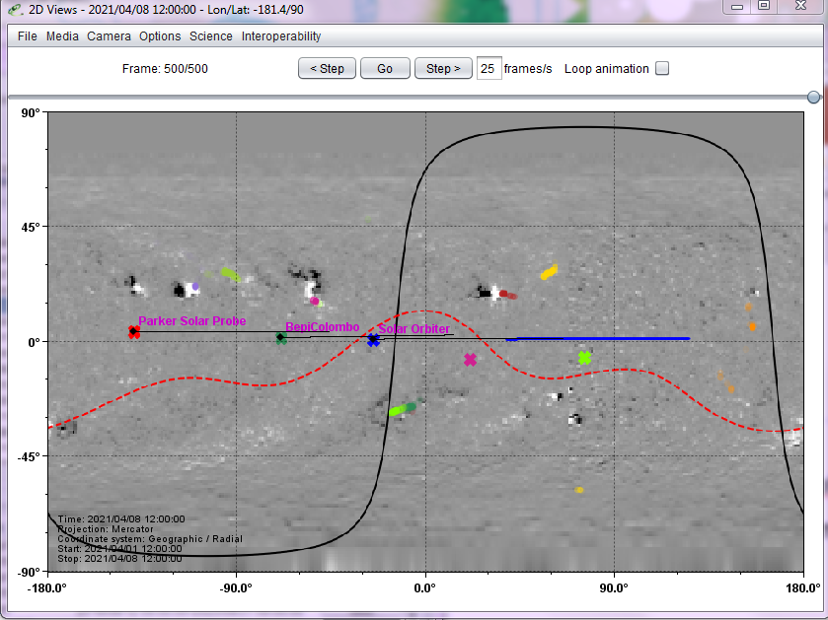
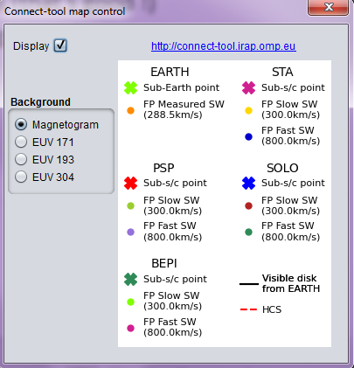
And again more information
Add « Connect-tool map » in the Science menu; see them changing with time
See that the radial footprints match in both tools (that’s good !)
See that the magnetic footprints do not match; guess why …

Slide 6
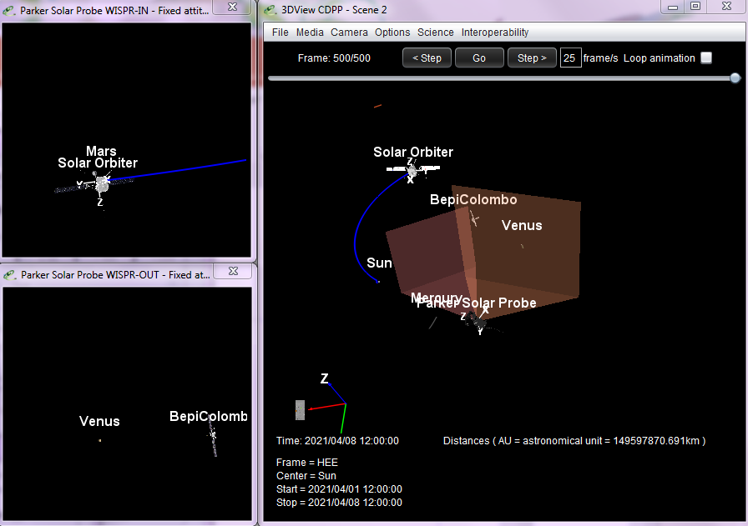
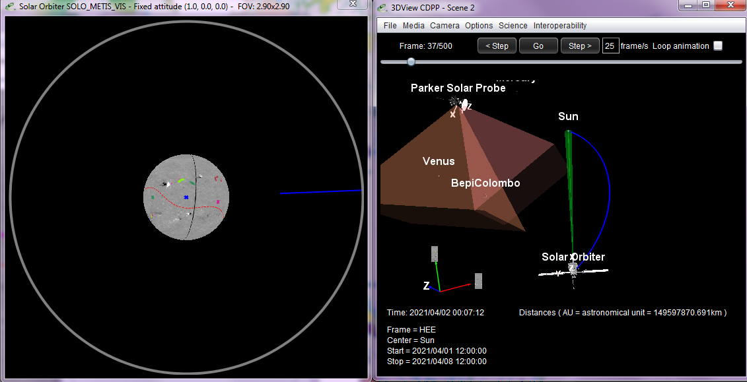
Finaly, instrument FOV
Options / View instrument FOV
PSP: WISPR-in, WISPR-out; SO: METIS (SO FOV values must still be validated)
WISPR-in
METIS
WISPR-out

Slide 7
AMDA use case #3
Not done last Tuesday; the results can be checked between 3DView and AMDA
Objectives:
Find orbital conjunctions between Solar Orbiter, BepiColombo and PSP
Construct and manage a catalogue of events
Based on the work done for the BepiCoordObs group
See Hadid et al., in preparation for Frontiers in Astronomy & Space Sciences

Slide 8
Magnetic footprints
“Magnetic alignments” between 2 or more bodies, i.e. when the footprints of Parker field lines passing through the bodies are in a latitude/longitude neighborhood at the source surface of the Sun
The longitude of the footpoint Φ_{s} is given by
Φ(r) is the spacecraft heliocentric longitude at distance r
Ω = 2π/25.38days
Rs = 2.5 R_{sun}
u_{SW} is the solar wind velocity
The latitude is equal to the one of the spacecraft as a Parker field line is inscribed on a cone of constant latitude

Slide 9
Parker alignments between spacecraft
Use AMDA data mining to determine time intervals when Solar Orbiter and BepiColombo have their magnetic footprints « close enough »
For instance |Φ_{s_SO} –Φ_{s_Bepi}|<3°
Time interval: Feb. 2020 - Dec. 2025
The solar wind velocity is an unknown
Start with u_{SW}=450 km/s
See how time intervals are modified for different velocities

Slide 10
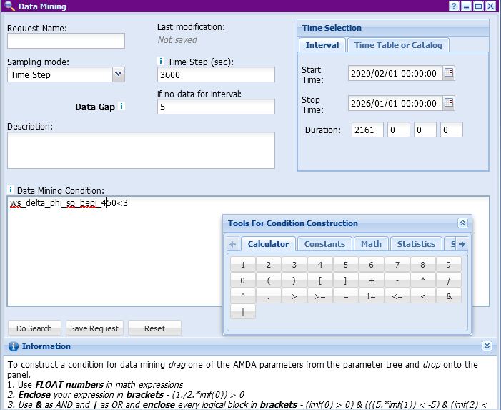
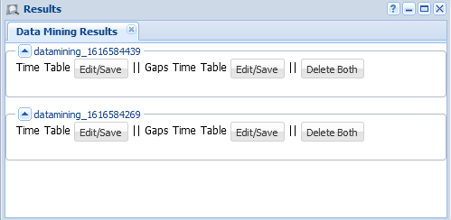
Data mining / conditional search
Name and save the ‘request’ for future use
Edit the time table
|Φ_{s_SO} –Φ_{s_Bepi}|<3°

Slide 11
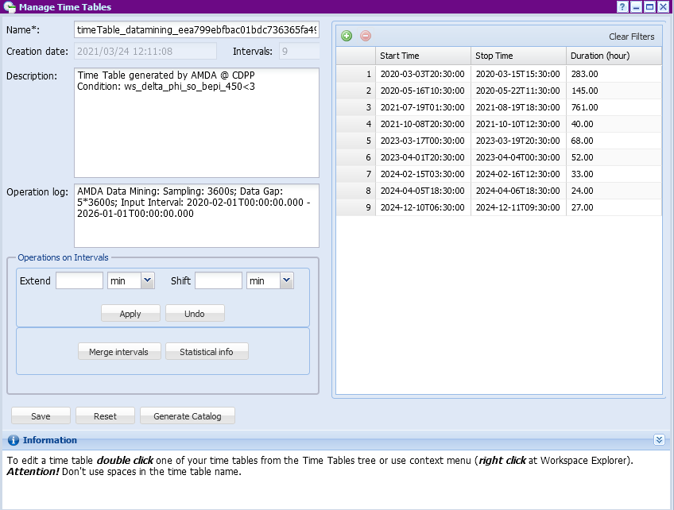
Default name
day/hour/min/sec can be set
Time intervals of the magnetic alignments between BepiColombo and Solar Orbiter for Feb. 2020 - Dec. 2025 with u_{SW}=450 km/s obtained with AMDA data mining
Change the defaut name and Save

Slide 12
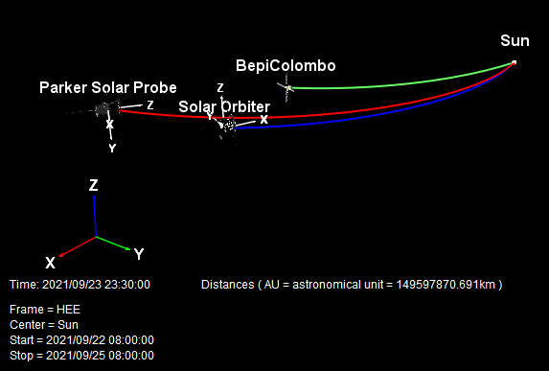
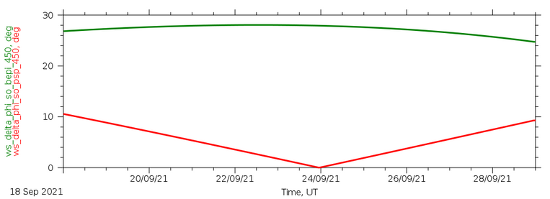
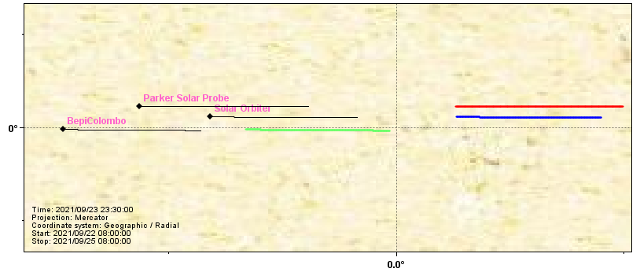
Solar Orbiter / PSP « Parker » conjunction (u_{SW}=450 km/s)
|Φ_{s_SO} –Φ_{s_Bepi}|
|Φ_{s_SO} –Φ_{s_PSP}|
28°
AMDA
: radial footprints
x: magnetic footprints
PSP/SO magnetic conjunction
x
x
x
28°
3DView
done with http://3dview.cdpp.eu/

